Slide 1



Open Source Security and Community
Protecting your open-source code and building a thriving community
JM (Jason Meridth) https://github.com/jmeridth
https://jmeridth.com

Slide 2


Notes:
Dependabot or Renovate
Scheduled checks and PRs
Custom registries
Open pull request limit
Grouping (minor and patch)
Auto-labeling

Slide 3

Notes:
GitHub Advanced Security:
Code scanning
CodeQL CLI
Secret scanning
Custom auto-triage rules
Dependency review

Slide 4
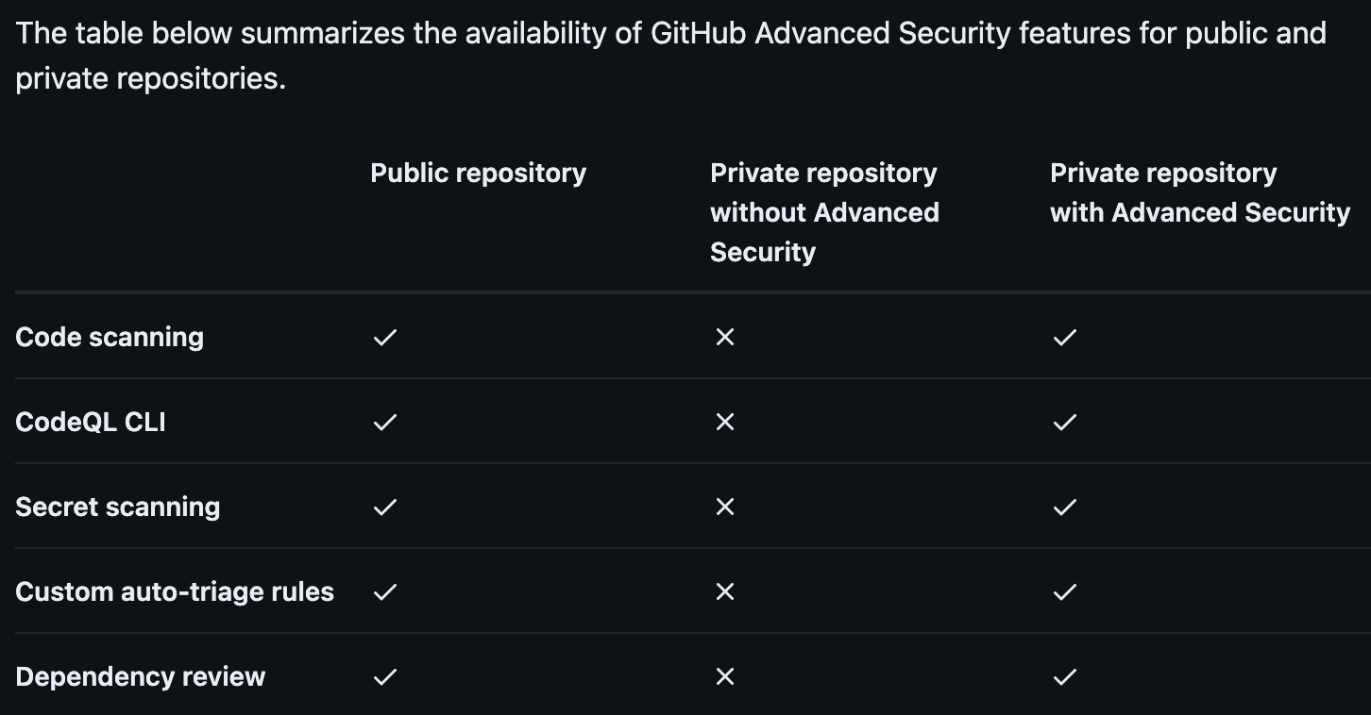
Notes:
Availability
Straight from the docs https://docs.github.com/en/get-started/learning-about-github/about-github-advanced-security
Public you get it all
Private without GHAS you get nothing
Private with GHAS you get it all

Slide 5
Public repo
Private repo
Code scanning
CodeQL CLI
Secret scanning
Custom auto-triage rules
Dependency review
w/ GHAS
w/o GHAS
Notes:
Availability
Straight from the docs https://docs.github.com/en/get-started/learning-about-github/about-github-advanced-security
Public you get it all
Private without GHAS you get nothing
Private with GHAS you get it all

Slide 6
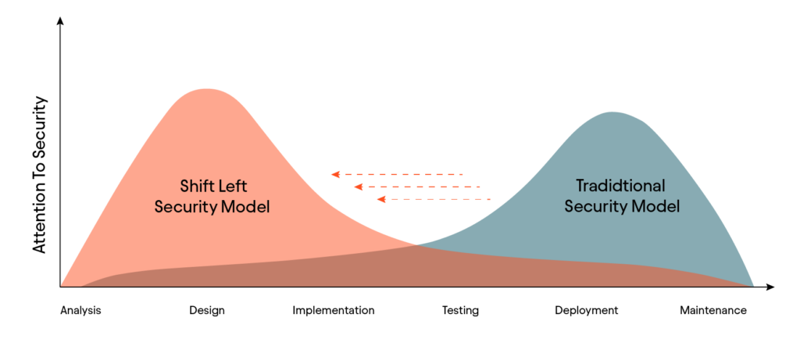
Notes:
Shift left (buzzword bingo)
Shift left security is a software development and security approach that involves integrating security practices earlier in the software development lifecycle (SDLC)

Slide 7

Notes:
Open source community

Slide 8

Notes:
https://opensource.guide/
https://github.com/github/opensource.guide, open source, come help maintain it

Slide 9

Notes:
CONTRIBUTING.md
Example: https://github.com/github/docs/blob/main/.github/CONTRIBUTING.md

Slide 10
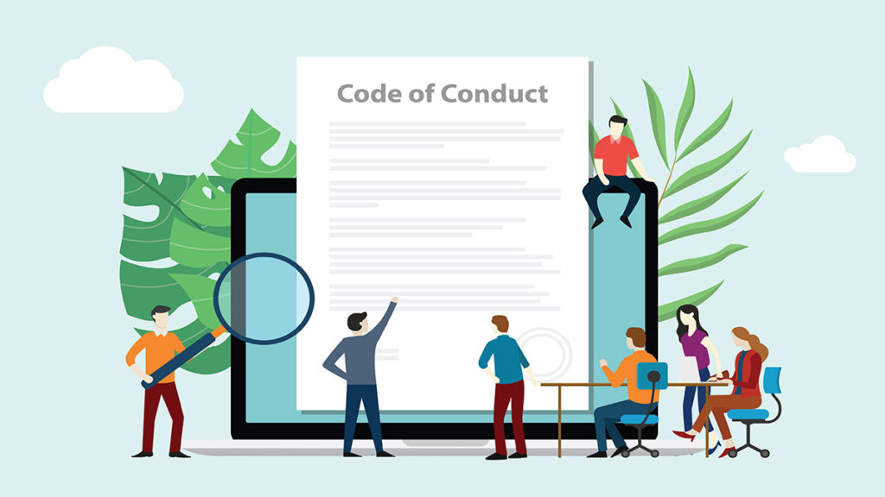
Notes:
Code of Conduct is very important
https://www.contributor-covenant.org/ is a great place to start
Includes standard and enforcement policy
Correction
Warning
Temporary Ban
Permanent Ban
HTML version
TL;DR don’t be an a-hole

Slide 11

Notes:
Reviewing PRs
Ask questions
Thank people for their contribution
State why you asking for change or denying their PR

Slide 12

Notes:
Good First Issues
Repo url + /contribute
https://goodfirstissues.com/
https://goodfirstissue.dev/

